Slide 1
TIRA WEBSITE
UNDER GUIDANCE OF MRS.VAISHALI SONAWANE MAM
By Ravada Eswari Lakshmi Priyanka

Slide 2
INTRODUCTION
Tira is a popular e-commerce website in India that specializes in beauty and lifestyle products.
It offers a wide range of products across various categories, including skincare, haircare, makeup, fragrances, and more.
Tira features a wide range of products from popular international and domestic brands.
Key Features:
Wide Product Range
Brand Variety
Search and Filter Options
Secure Payment Options

Slide 3
RESPONSIBILITIES
ANALYZE EACH MODULE AND SUB-MODULE
CREATE TEST PLAN ON EACH MODULE
WRITING AND EVALUATING TEST CASES
PERFORMI BOTH MANUAL AND AUTOMATION TESTING
CREATE DEFECT REPORT

Slide 4
OVERVIEW
WHAT IS TIRA?
BEAUTY AND WELLNESS E-COMMERCE PLATFORM: TIRA IS AN ONLINE PLATFORM THAT SPECIALIZES IN BEAUTY AND LIFESTYLE PRODUCTS.
WIDE RANGE OF PRODUCTS: OFFERS PRODUCTS ACROSS VARIOUS CATEGORIES, INCLUDING: - SKINCARE - HAIRCARE - MAKEUP - FRAGRANCES - AND MORE
POPULAR BRANDS: ALLOWS USERS TO BROWSE AND PURCHASE PRODUCTS FROM POPULAR BRANDS.

Slide 5
MODULES
MODULE 1: MY ACCOUNT
Checked all the functionalities including personal details, address, orders
MODULE 2: MY BAG
Checked all the functionalities including max and min quantity of products. Adding and removing products
MODULE 3:HELP CENTER
Checked all the functionalities including required fields and uploading images
MODULE 4: MENU
Checked all the functionalities including brands, offers, top shelf, for you, tira red
MODULE 5: MULTI- SEARCH
Checked the search functionalities by giving multiple search items

Slide 6
MODULE 6: GIFTS
Checked all the functionalities including for her, for him, occasion and free gifts too.
MODULE 7: MY WISHLIST
Checked all the functionalities whether products are added and removed from Wishlist and further added to cart
MODULE 8: SUBSCRIPTION
Checked all the functionalities including mail id fields and save button to get notify from Tira.
MODULE 9: SOCIAL MEDIA
Checked all the functionalities like WhatsApp, Instagram and Facebook.
MODULE 10: FAQ’s
Checked all the functionalities of all the queries and related responses.

Slide 7
DEFECTS
DEFECT 1 :
Product is active in catalog, but shows 'Product not found' in My Bag with incorrect count
DEFECT 2 :
Without login and email verification, the web is accepting invalid email IDs and allowing users to raise tickets for queries in Help Center module.

Slide 8
DEFECT IDENTIFIER:- B_001
Defect identifier :- B_001
Ø Defect summary :-Product is active in catalog, but shows 'Product not found' in My Bag with incorrect count
Ø Test Id :- TC_001
Ø Test case name :- TC__inactive__prod
Ø Module name :- My Bag
Ø Reproducible :-
Ø Severity :- high
Ø Priority :- high
Ø Raised by :- Eswari R.L.P
Ø Assigned to :- developer Team lead
Ø Date of assignment :- 08-08-2025
Ø Status :- pending
Ø Fixed by :- developer
Ø Date of fixing :-

Slide 9
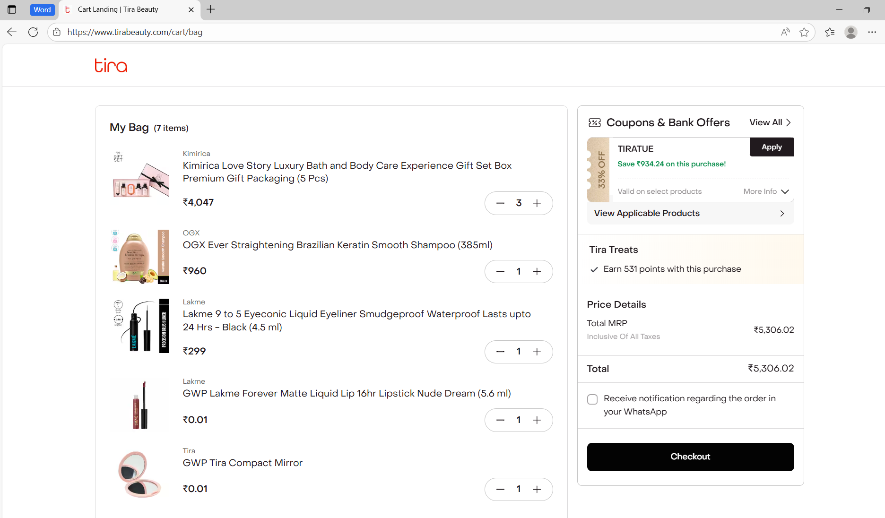
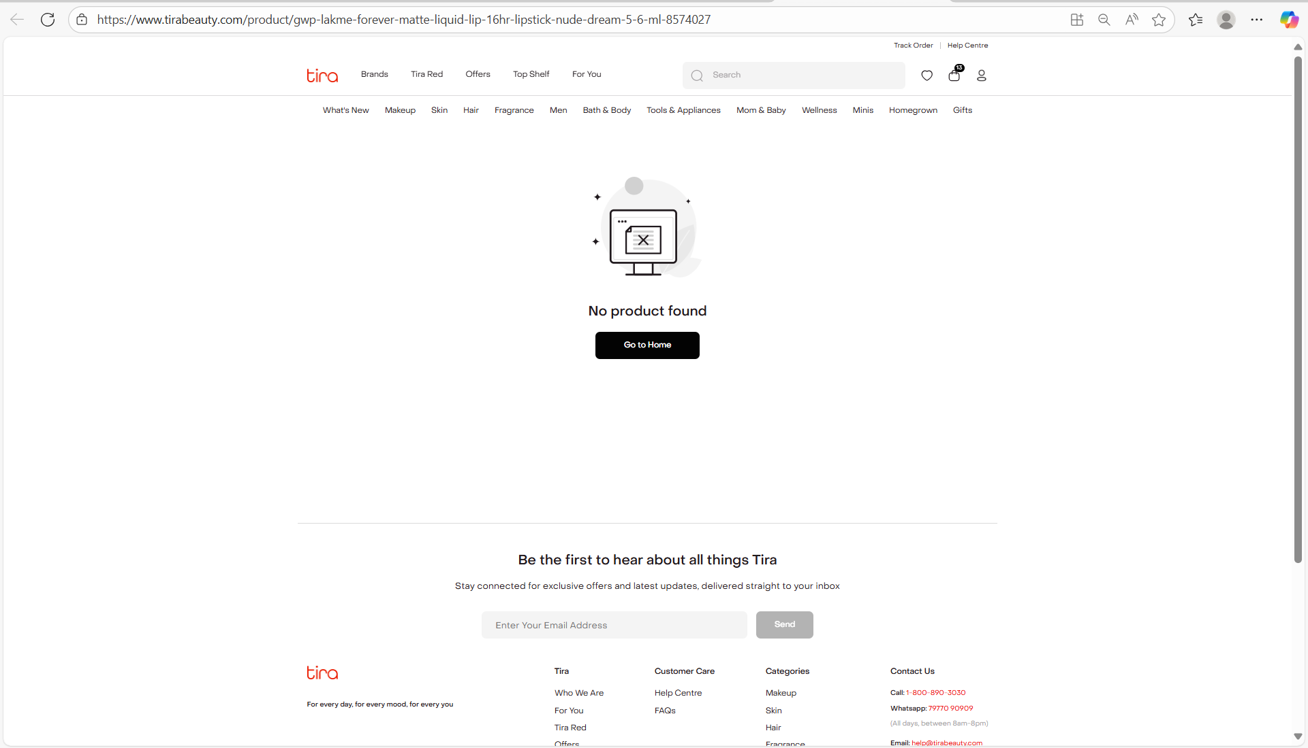

Slide 10
DEFECT IDENTIFIER:- B_002
Defect identifier :- B_002
Ø Defect summary :- Without login and email verification, the system is accepting invalid email IDs and allowing users to create tickets for queries
Ø Test Id :- TC_002
Ø Test case name :- TC_creating_tickets
Ø Module name :- Help center
Ø Reproducible :-
Ø Severity :- high
Ø Priority :- high
Ø Raised by :- Team lead
Ø Assigned to :- developer Team lead
Ø Date of assignment :- 08-08-2025
Ø Status :- pending
Ø Fixed by :- developer
Ø Date of fixing :-

Slide 11
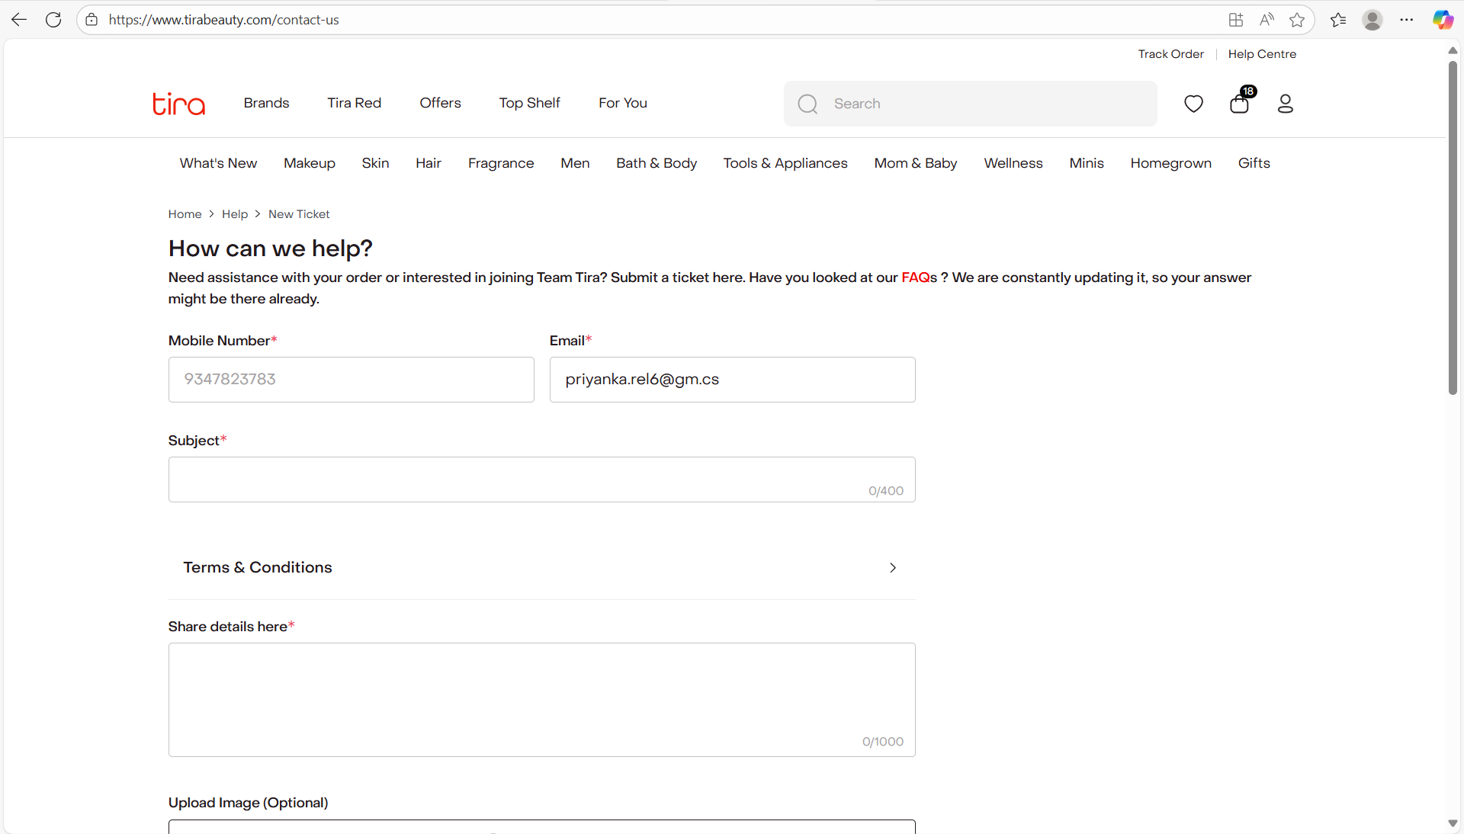
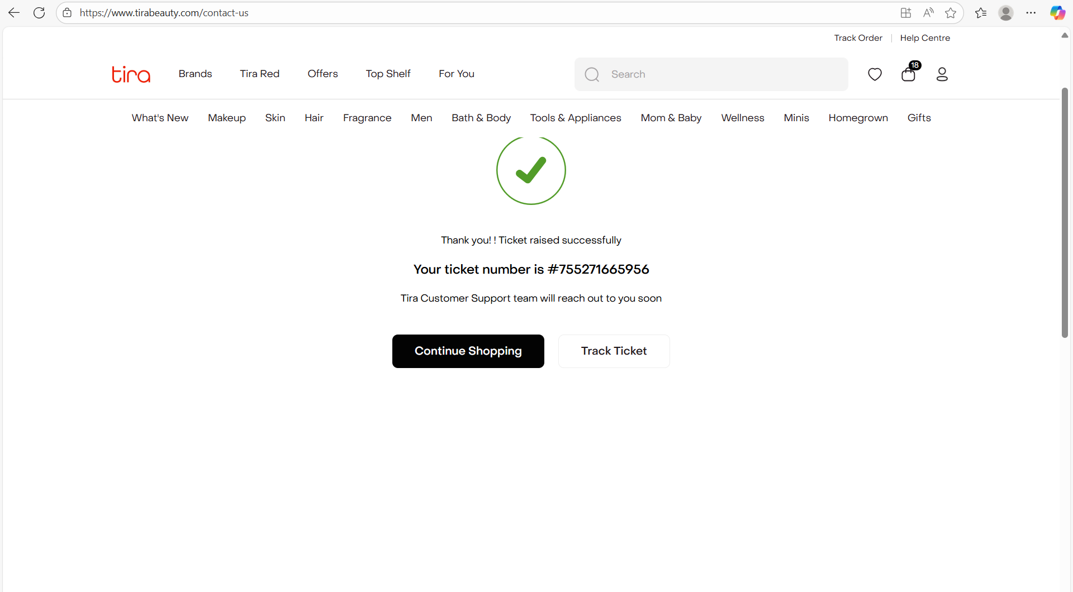

Slide 12
CHALLENGES
Handling Dynamic Content: One of the biggest challenges was handling dynamic content on the website, such as promotional banners and catalogs.
There comes difference in writing a test case and executing them.
So, the best practice is to use unique identifiers, such as IDs or classes, to identify elements.

Slide 13
EXPERIENCE
I have had the opportunity to test the Tira website both manually and through automation.
Started by exploring the website, navigating through different sections, and identifying potential issues.
Functional Testing: I tested various functionalities, such as searching for products, adding items to cart, and checking out
I created automated test scripts using Selenium WebDriver to test the website's functionality, product search, and checkout. .

Slide 14
Thank You!!!
VAISHALI MAM For Guiding Us through out the Project

